Slide 1
Lecture 2
Topics
Binary Arithmetic (Unsigned binary operands)
Signed number representations
Signed Magnitude
Diminished Radix Complement (Ones Complement)
Radix Complement (Twos Complement)
Binary Arithmetic Revisited and Overflow
Sign Extension

Slide 2
Binary Arithmetic
Rules for “carry” same as in decimal
Here are the rules for adding of each bit
carry
1
0
0
0
0
1
1
1
0
1
1
1
10
+
+
+
+
carry

Slide 3
Unsigned Binary (UB) Addition
Examples (4-bit word)
2 + 6
11 + 6
1
1
1
1
1
11
+ 6
17
0010
0110
2
+ 6
8
1011
0110
+
+
1000
10001
Overflow
17 > 2⁴-1

Slide 4
Overflow (Underflow)
Definition:
Result of an arithmetic operation is too large (or small) to be represented in number of bits available
Detection:
Varies with the representation. For unsigned binary, it’s determined by a carry out of the MSB
1
1
1
1
1
10101101
01101100
8 bit operands
+
100011001

Slide 5
Signed Numbers
Have been assuming non-negative numbers
Unsigned Binary (UB)
Several representations for signed numbers
Sign Magnitude (SM)
Diminished Radix Complement (DRC)
1s Complement
Radix Complement (RC)
2s Complement

Slide 6
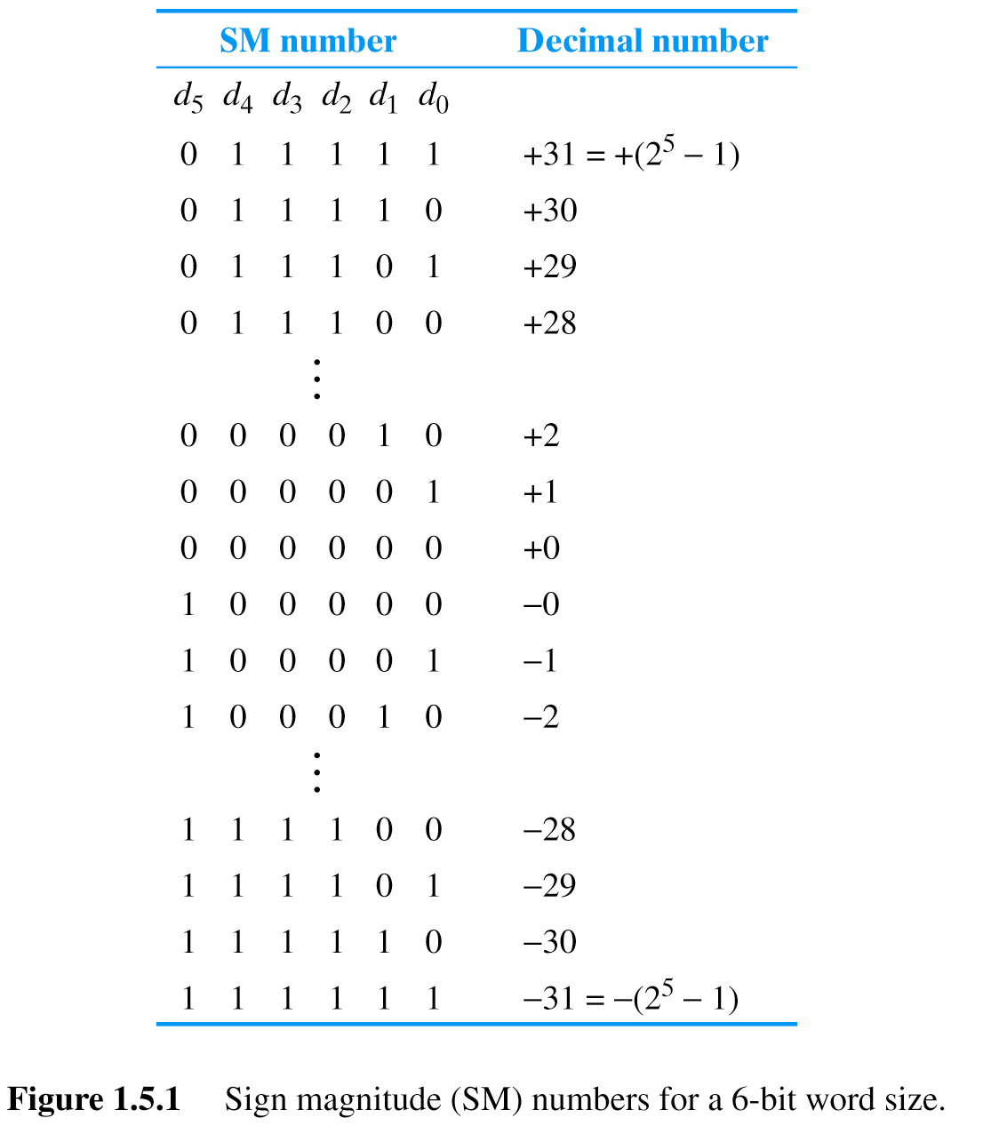
Sign Magnitude
MSB functions as sign bit
0 = positive
1 = negative
Range of numbers:
-(2^{n-1} – 1) to +(2^{n-1} – 1)
n = 6
Two representations for 0
Negative formed by complementing sign bit
15₁₀ = 001111_{SM}
-15₁₀ = 101111_{SM}
010100_{SM} = 20₁₀
110100_{SM} = -20₁₀

Slide 7
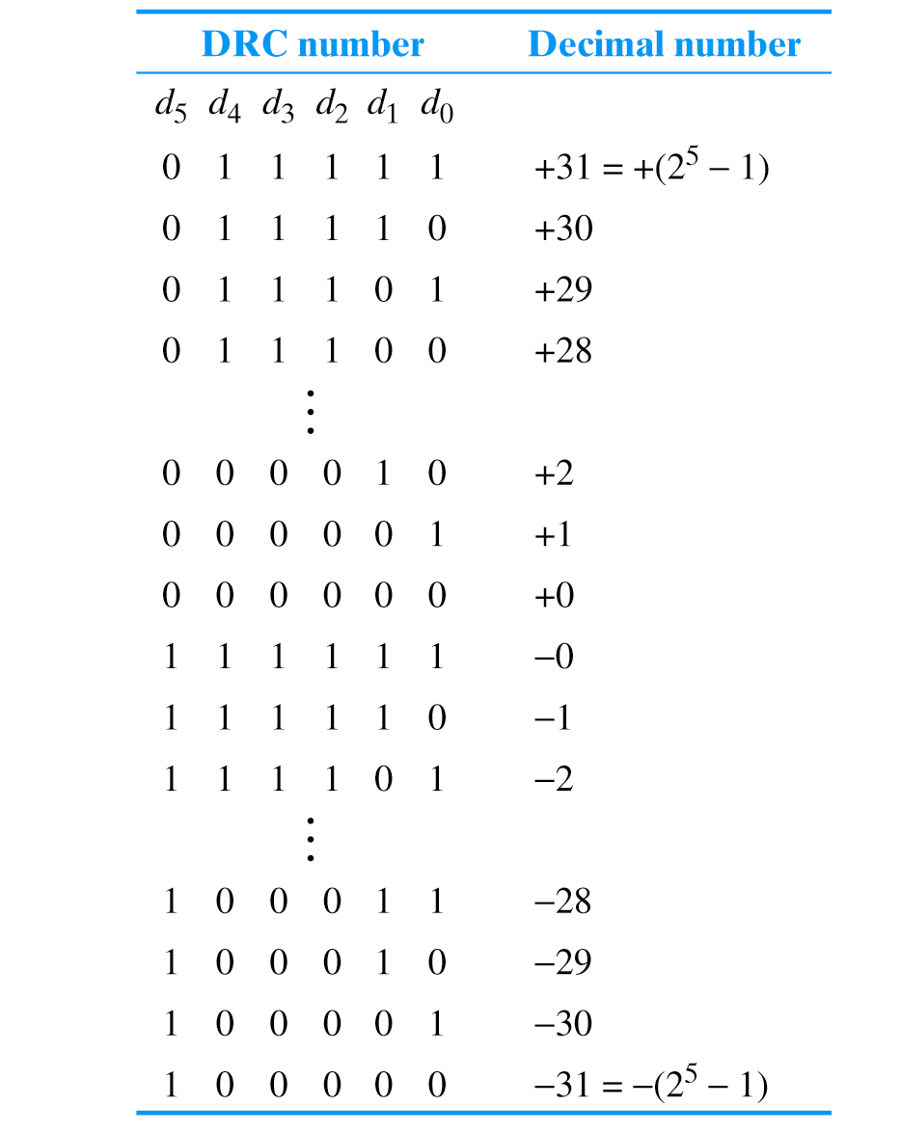
Diminished Radix Complement (DRC)
Called “Ones Complement”
MSB indicates sign
0 = positive
1 = negative
(but not a sign bit!)
Range of numbers:
-(2^{n-1} – 1) to +(2^{n-1} – 1)
Two representations for 0
Negative formed by complementing entire word
(called “taking the ones complement”)
15₁₀ = 001111_{DRC}
-15₁₀ = 110000_{DRC}
010100_{DRC} = 20₁₀
101011_{DRC} = -20₁₀

Slide 8
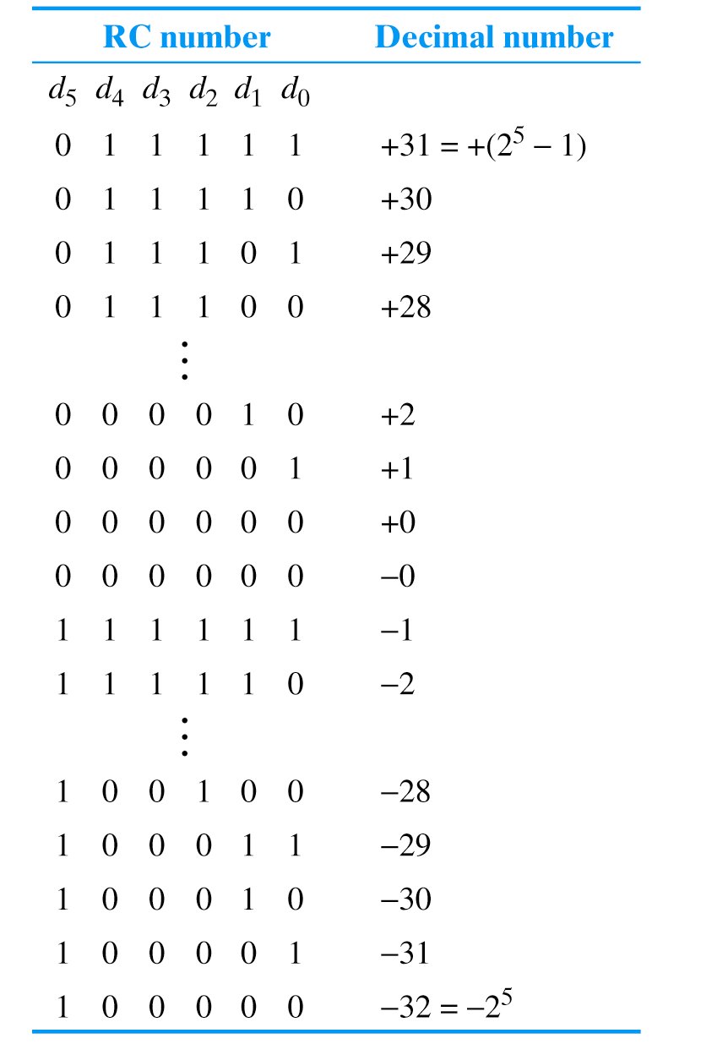
Radix Complement (RC)
Called “Twos Complement”
MSB indicates sign
0 = positive
1 = negative
(but not a sign bit)
Range of numbers:
-(2^{n-1}) to +(2^{n-1} – 1)
Only one representation for 0
Negative formed by complementing entire word
and adding 1 (called “taking the twos complement”)
15₁₀ = 001111_{RC}
-15₁₀ = 110001_{RC}
010100_{RC} = 20₁₀
101100_{RC} = -20₁₀

Slide 9
Twos Complement – Special Cases
Notes:
Note: Discard carry out of sign bit position!

Slide 10
Twos Complement – Special Cases
Example: Take Twos Complement (RC)
of 0000 (0₁₀)
0000
1111
+ 1
0000
1
1
1
Only one representation for 0
Complement
Add One
Ignore carry out of MSB
Note: Discard carry out of sign bit position!

Slide 11
Twos Complement – Special Cases
Example: Take Twos Complement (RC)
of 1000 (-8₁₀) (most negative)
-8₁₀
Can’t represent
Complement of the most negative number
1000
0111
+ 1
1000
1
1
1
Complement
+8₁₀ is not represented
Add One
1000 (-8₁₀) is the most negative number
Notes:
Note: Discard carry out of sign bit position!

Slide 12
Conversions of Signed Representations
Unsigned Binary
From decimal
Represent the absolute value of the number in UB
Use the correct number of bits (add leading 0s)
If the decimal number is negative, use the appropriate rule to negate the representation
S/M – complement the sign bit
DRC (ones complement) – complement every bit
RC (twos complement) – complement every bit, add 1
To decimal
If number is +, convert from UB to decimal (done!)
If number is - use appropriate rule to negate it (obtain its absolute value)
S/M – complement the sign bit
DRC (ones complement) – complement every bit
RC (twos complement) – complement every bit, add 1
Convert this (positive) number as though UB to decimal
Add a negative sign
Sign Magnitude

Slide 13
Why do we use RC (Twos Complement)?
Only one representation for zero
Simplified Addition
Sign Magnitude Addition
Must consider two operands without sign bits
If sign bits same: perform add, check overflow
If sign bits different: subtract (two cases)
+A and – B → A – B
– A and + B→ B – A
Generate correct sign bit for sum
Radix Complement (Twos Complement) Addition
Just add!
Simple Subtraction
Done via addition
A + B
A – B = A + (-B)
Caution: Can’t take negative of most negative number
BCD (which we’ll see shortly) was used in very early 4-bit microprocessors, but 2s complement is universally used now

Slide 14
Binary Arithmetic
Unsigned Binary (UB)
Signed Binary (SB)
Diminished Radix Complement (DRC)
1s complement
Radix Complement (RC)
2s complement
Rarely used

Slide 15
Radix Complement (RC) or Twos Complement Addition
Examples (4-bit word)
7 + (-2)
5 + (-7)
1
1
1
1
0101
1001
5
+ (-7)
(-2)
0111
1110
7
+ (-2)
5
+
+
1110
10101
Ignore carry out of MSB

Slide 16
Radix Complement (RC) or Twos Complement Addition
Examples (4-bit word)
-7 + (-2)
We added two negative numbers and got a positive result!
1
1001
1110
-7
+ (-2)
-9
+
10111
Overflow!!
-9 < - (2³)
Ignore carry out of MSB

Slide 17
Carry and Overflow

Slide 18
Carry and Overflow
Is this an overflow condition?
1
1
1
0
1
1
0
0
10101101
01101100
+
100011001
If this is an unsigned binary (UB) number – Yes!

Slide 19
Carry and Overflow
Is this an overflow condition?
1
1
1
0
1
1
0
0
10101101
01101100
+
100011001
If this is a radix complement (RC) number – No!
A negative number plus a positive number cannot produce an overflow

Slide 20
Carry and Overflow Radix Complement (2s Complement)
Consider:
Positive + Negative → Never overflow
Negative + Negative → Overflow possible
Positive + Positive → Overflow possible
Detecting Overflow:
If signs of addends are same and sign of sum is different
Equivalent to C_{SBP} ≠ C_{SBP+1}
C – Carry
SBP – Sign Bit Position

Slide 21
Carry and Overflow
C_{SBP} = C_{SBP+1}
C_{SBP+1}
C_{SBP}
C – Carry
SBP – Sign Bit Position
1
1
1
0
1
1
0
0
10101101
01101100
+
100011001

Slide 22
Radix Complement (RC) Addition
Examples (4-bit word)
C_{SBP+1} ≠ C_{SBP}
-7 + (-2)
We added two negative numbers and got a positive result!
C_{SBP+1}
C_{SBP}
1
0
0
0
1001
1110
-7
+ (-2)
-9
+
10111
Overflow!
-9 < - (2³)
Conclusion on Overflow in 2s Complement:
There is an overflow if signs of addends are same and sign of sum is different
Equivalent to C_{SBP} ≠ C_{SBP+1}
Notes:
Returning to our previous example…

Slide 23
Sign Extension
What happens when you move a number from a smaller word size to a larger one?
UB
S/M
RC (2s complement)
00000011
0000000000000011
(3)
(3)
00000011
0000000000000011
(3)
(3)
00000011
0000000000000011
(3)
(3)
11111101
0000000011111101
(253)
(253)
11111101
1000000001111101
(-125)
(-125)
11111101
0000000011111101
(-3)
(+253!)
bad
Unsigned Binary is no problem, fill with zeros
Sign Magnitude is no problem, sign goes to MSB
11111101
1111111111111101
(-3)
(-3)
good
“extend” the sign bit left through the new MSB
23

Slide 24
Radix Complement (RC)
Called “Twos Complement”
MSB indicates sign
0 = positive
1 = negative
(but not a sign bit)
Range of numbers:
-(2^{n-1}) to +(2^{n-1} – 1)
Only one representation for 0
Negative formed by complementing entire word
and adding 1 (called “taking the twos complement”)
15₁₀ = 001111_{RC}
-15₁₀ = 110001_{RC}
010100_{RC} = 20₁₀
101100_{RC} = -20₁₀
1 1 1 1 0 1
-3

Slide 25
Sources
Prof. Mark G. Faust

